Slide 1
JSON basics
learn more at:
https://www.w3schools.com/js/js_json_intro.asp

Slide 2
JSON
JSON = Javascript Object Notation
It is a string representation of javascript data objects.
Data objects because JSON does not allow functions, or Dates for example.
Node, and Browsers, provide a JSON global function that can turn a javascript object into a JSON string:
var jsonString = JSON.stringify(obj)
and a parser to turn a JSON string back into an object:
var obj = JSON.parse(jsonString)

Slide 3
JSON
Observations:
There is no such thing as a JSON object per se. JSON is a string representation of objects. (Though people often talk about passing JSON objects around).
JSON is easy to move or store because it is just text and easy to parse with javascript's built in JSON function object.

Slide 4
Javascript Object vs. JSON
var obj = { name: 'Lou', date: new Date(),
getName: function() {return this.name}
}
var jsonString = JSON.stringify(obj);
var obj2 = JSON.parse(jsonString);
'{"name":"Lou","date":"2015-08-07T22:49:09.047Z"}'
{ name: 'Lou', date: '2015-08-07T22:49:09.047Z' }
Observations:
When you JSON.stringify() an object, functions are ignored, dates are turned into strings.
Also, JSON strings only allow double quotes for keys, not single or double quotes the way javascript allows. (The single quote is used to delimit the overall string.)

Slide 5
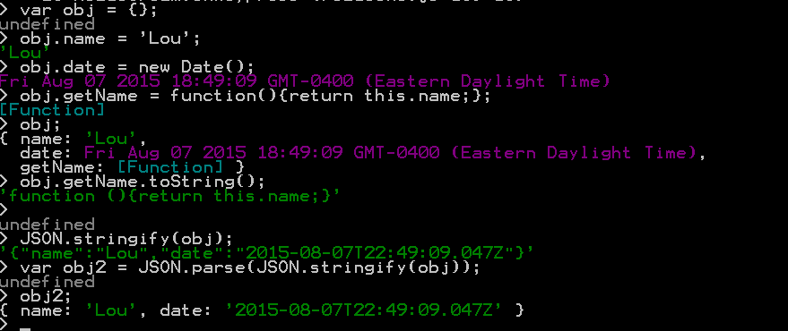
JSON stringify() and parse() session
JSON experiment.
Observations:
When you JSON.stringify() and object. Functions are ignored, dates are turned into strings.
Also, JSON strings only allow double quotes for key names (not single quotes).

Slide 6
Data Interchange Schemes
Three data interchange formats are the most popular with web apps:
XML (Extendable Markup Language)
JSON (Javascript Object Notation)
URI Encoded Data
All three are popular for data interchange (transmitting data through a network).
XML and JSON both also popular as configuration data.

Slide 7
URI Encoded Data
var uri = "my test.asp?name=ståle&car=saab"
console.log(encodeURI(uri)) my%20test.asp?name=st%C3%A5le&car=saab
console.log(encodeURIComponent(uri)) my%20test.asp%3Fname%3Dst%C3%A5le%26car%3Dsaab
var enc = "my%20test.asp?name=st%C3%A5le&car=saab"
console.log(decodeURI(enc))
my test.asp?name=ståle&car=saab
enc = "my%20test.asp%3Fname%3Dst%C3%A5le%26car%3Dsaab”
console.log(decodeURIComponent(enc))
my test.asp?name=ståle&car=saab

Slide 8
XML vs JSON
<?xml version="1.0" encoding="UTF-8"?>
<song>
<title> 26-2 </title>
<composer> John Coltrane </composer>
<musicalStyle> Medium Up Swing </musicalStyle>
<key> F </key>
<bar>
<timeSignature> 4/4 </timeSignature>
<rehearsalLetter> A </rehearsalLetter>
<leftDoubleBarLine/>
<chords> Fmaj7 / Ab7 </chords>
</bar>
<bar>
<chords> Dbmaj7 / E7 </chords>
</bar>
<bar>
<chords> Amaj7 / C7 </chords>
</bar>
<bar>
<chords> Cm7 / F7 </chords>
</bar>
<bar>
<finalBarLine/>
<chords> Fmaj7 </chords>
</bar>
</song>
{
"title": "26-2",
"composer": "John Coltrane",
"musicalStyle": "Medium Up Swing",
"key": "F",
"bars": [
{
"timeSignature": "4/4",
"rehearsalLetter": "A",
"leftDoubleBarLine": "true",
"chords": "Fmaj7 / Ab7",
},
{
"chords": "Dbmaj7 / E7",
},
{
"chords": "Amaj7 / C7",
},
{
"chords": "Cm7 / F7",
},
{
"finalBarLine": "true",
"chords": "Fmaj7",
}
]
}

Slide 9
XML vs JSON
<?xml version="1.0" encoding="UTF-8"?>
song>
<title> 26-2 </title>
<composer> John Coltrane </composer>
<musicalStyle> Medium Up Swing </musicalStyle>
<key> F </key>
<bar>
<timeSignature> 4/4 </timeSignature>
<rehearsalLetter> A </rehearsalLetter>
<leftDoubleBarLine/>
<chords> Fmaj7 / Ab7 </chords>
</bar>
<bar>
<chords> Dbmaj7 / E7 </chords>
</bar>
<bar>
<chords> Amaj7 / C7 </chords>
</bar>
<bar>
<chords> Cm7 / F7 </chords>
</bar>
<bar>
<finalBarLine/>
<chords> Fmaj7 </chords>
</bar>
</song>
{
"title": "26-2",
"composer": "John Coltrane",
"musicalStyle": "Medium Up Swing",
"key": "F",
"bars": [
{
"timeSignature": "4/4",
"rehearsalLetter": "A",
"leftDoubleBarLine": "true",
"chords": "Fmaj7 / Ab7",
},
{
"chords": "Dbmaj7 / E7",
},
{
"chords": "Amaj7 / C7",
},
{
"chords": "Cm7 / F7",
},
{
"finalBarLine": "true",
"chords": "Fmaj7",
}
]
}
How do we know this is
a song?
How do we know this is
a bar?
What is the implication of
finalBarLine: "false"

Slide 10
XML vs JSON –JSON trick 1
{"song",
{
"title": "26-2",
"composer": "John Coltrane",
"musicalStyle": "Medium Up Swing",
"key": "F",
"bars": [
{
"timeSignature": "4/4",
"rehearsalLetter": "A",
"leftDoubleBarLine": "true",
"chords": "Fmaj7 / Ab7",
},
{
"chords": "Dbmaj7 / E7",
},
{
"chords": "Amaj7 / C7",
},
{
"chords": "Cm7 / F7",
},
{
"finalBarLine": "true",
"chords": "Fmaj7",
}
]
}
}
song>
<title> 26-2 </title>
<composer> John Coltrane </composer>
<musicalStyle> Medium Up Swing </musicalStyle>
<key> F </key>
<bar>
<timeSignature> 4/4 </timeSignature>
<rehearsalLetter> A </rehearsalLetter>
<leftDoubleBarLine/>
<chords> Fmaj7 / Ab7 </chords>
</bar>
<bar>
<chords> Dbmaj7 / E7 </chords>
</bar>
<bar>
<chords> Amaj7 / C7 </chords>
</bar>
<bar>
<chords> Cm7 / F7 </chords>
</bar>
<bar>
<finalBarLine/>
<chords> Fmaj7 </chords>
</bar>
</song>
How do we know this is
a song?
How do we know this is
a bar?
What is the implication of
finalBarLine: "false"

Slide 11
XML vs JSON –JSON trick 2
{"songs": [
{
title: "26-2",
composer: "John Coltrane",
musicalStyle: "Medium Up Swing",
key: "F",
bars: [
{
timeSignature: "4/4",
rehearsalLetter: "A",
leftDoubleBarLine: "true",
chords: "Fmaj7 / Ab7",
},
{
chords: "Dbmaj7 / E7",
},
{
chords: "Amaj7 / C7",
},
{
chords: "Cm7 / F7",
},
{
finalBarLine: "true",
chords: "Fmaj7",
}
]
}
] }
song>
<title> 26-2 </title>
<composer> John Coltrane </composer>
<musicalStyle> Medium Up Swing </musicalStyle>
<key> F </key>
<bar>
<timeSignature> 4/4 </timeSignature>
<rehearsalLetter> A </rehearsalLetter>
<leftDoubleBarLine/>
<chords> Fmaj7 / Ab7 </chords>
</bar>
<bar>
<chords> Dbmaj7 / E7 </chords>
</bar>
<bar>
<chords> Amaj7 / C7 </chords>
</bar>
<bar>
<chords> Cm7 / F7 </chords>
</bar>
<bar>
<finalBarLine/>
<chords> Fmaj7 </chords>
</bar>
</song>
How do we know this is
a song?
How do we know this is
a bar?
What is the implication of
finalBarLine: "false"

Slide 12
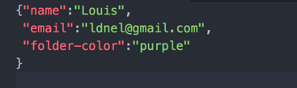
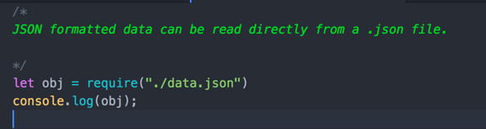
JSON configuration data
JSON integrates very conveniently with Javascipt.
Data configuration files in JSON format can be read directly into javascript object variables using node.js require() mechanism
data.json
test.js

Slide 13
JSON as interchange data format
JSON is the primary format for moving data between web clients and javascript-based servers (like node.js-based servers)
XML was more popular with non javascript-based servers and large application templates (e.g. MusicXML)

